Slide 1


Python Tsunami
– November 3rd-5th –

Slide 2





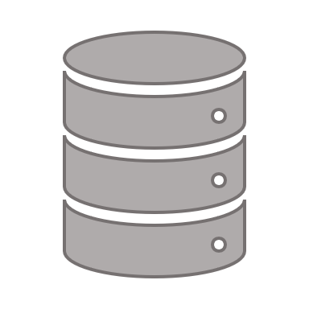




Center for Health Data Science
https://heads.ku.dk
The Data Science lab:
Provides data science support for all research groups at SUND
Organizes workshops/seminars
Research units:
work on different areas and topics within the field of health data science

Slide 3









The Team
Thilde Terkelsen (HeaDS)
Annelaura Bach Nielsen (NNF CPR)
Jose Alejandro Herrera Romero - Alex (HeaDS)
Marilena Hohmann (HeaDS)
Rita Colaço (PRI)
Inigo Prada Luengo (HeaDS)
Viktoria Schuster (HeaDS)
Henry Webel (NNF CPR)
Albert J. Kooistra (DDP SUND)
Jimmy Caroli (DDP SUND)

Slide 4

Former Team Members
Alberto Santos Delgardo (HeaDS)
Dhouha Grissa (NNF CPR)
Grzegorz Jerzy Maciag (BRIC)
Katerina Nastou (NNF CPR)
Kübra Altinel (BRIC)
Annelaura Bach Nielsen (NNF CPR)
Marta Matos (GENOME Center)
Nicholas Luke Cowie (DTU)

Slide 5
Practical Things about the Course
Program
Coffee and Q&A
Teams
Breakout rooms
Datathon

Slide 6
Practical Things about the Course -- Program --
 | Wednesday | Thursday | Friday
9:00-09:45 |  | Conditions | Visualization I
9:45-10:00 | Coffee break
10:00-11:00 | Introduction & Tools | Loops | Visualization II
11:00-12:00 | Variables and data types | Functions
 | Numbers and operators
12:00-13:00 | Lunch break
13:00-14:00 | Importing data | Numpy | Datathon
14:00-14:45 | Data structures
14:45-15:15 | Coffee break
15:15-15:45 | Data structures | Pandas | Datathon
15:45-16:30 |  |  | Presentations

Slide 7
Practical Things about the Course -- Teams --
52 participants divided into 8 fixed teams
2 working modes:
Individual: exercises
Teamwork: discussions, practice and the Datathon

Slide 8
Practical Things about the Course -- Datathon --
A Datathon is a data-focused competition — given a dataset and a limited amount of time, participants are challenged to use their creativity and data science skills to:
Build
Dataset
Test
Solutions
Explore

Slide 9
Practical Things about the Course -- Datathon --
A Datathon is a data-focused competition — given a dataset and a limited amount of time, participants are challenged to use their creativity and data science skills to:
Build
Dataset
Test
Solutions
Explore

Slide 10
What will you learn in this course?
Tools to work with Python
The basics of Python
Some of the most relevant scientific libraries
Visualization
Good practice

Slide 11
Motivation
Why will programming help you?
Programming is yet another laboratory technique
It helps you automate processes that you need to repeat again and again
It will save you time
It gives you freedom to process, analyze and plot your data as you want
It will help you demystify bioinformatics
It will facilitate communication with bioinformaticians
It will improve your CV

Slide 12
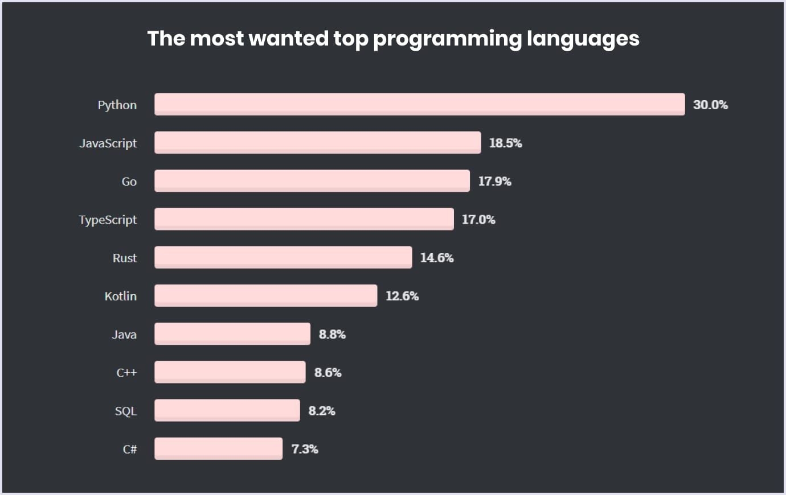
Why Python?
Python is easy to use, powerful, and versatile
A great choice for beginners and experts alike
Python’s readability makes it a great first programming language
It has a huge community behind developing useful libraries in many different fields (i.e biology, imaging, etc.)
It can be optimized easily

Slide 13
Basic concepts
What’s programming?
Variables, Functions
How do you approach a problem?
Car example
Class, Object, attribute, functions

Slide 14
What’s programming
Programming is a way of communicating with a device: computer, cellphone, …, machine of any kind
This communication is possible if you speak a language that the machine understands
Programming is not difficult, mastering it might be a bit more challenging

Slide 15
Variables
variable_name = value
Variable is a way of storing values that you want to use later
To define variables, we use name of variable and ‘=‘ to assign values:
my_first_variable = 3
Variables can have different types:
my_first_variable = 3 # integer
my_second_variable = “This is my second variable” # string
my_third_variable = 3.0 # float

Slide 16
Functions
Function is the way to define actions, i.e sum, print on the screen.
To define functions, we use the reserved word def:
def sum_two_numbers(a, b):
return a + b
def say_hi():
print(“Hi”)
Functions can be called by their name and specifying the parameters:
sum_two_numbers(a=7, b=5)
> 12
say_hi()
> Hi
def function_name (parameters)

Slide 17
Strategy for Programming
Problem
Divide and conquer
subproblem
subproblem
subproblem

Slide 18
The Car Problem
Describe this object:
Parts: wheels, a steering wheel, a frame, etc.
Actions: moves, breaks, etc.
Describe a car
Problem
subproblem
subproblem
subproblem

Slide 19
The Car Problem
Describe this object → Class:
Parts: wheels, a steering wheel, a frame, etc. → variables or attributes
Actions: start, change gear, etc. → functions
Describe a car
Problem
Variables:
color = “blue”
number_of_wheels = 4
motor = True
power = “gas”
gear = None
Functions:
def start_engine():
. . .
def change_gear(gear):
. . .
subproblem
subproblem
subproblem

Slide 20


Coffee with your team
Introduce yourself and what you do
Explain your motivation to take the course
Discuss what data could be relevant for you

Slide 21
Python Tsunami
Installation and Tools
– November 3rd-5th –

Slide 22
How do I work with Python?
Setting up Python
Virtual Environments
Jupyter Notebooks
Google Colab

Slide 23
How do I work with Python?
Setting up Python
Virtual Environments
Jupyter Notebooks
Google Colab

Slide 24

Setting up Python
Pros:
Your own local installation
Easy access to data stored locally
More control over installed versions
Not difficult if done right
Cons:
May require solving issues (sometimes obscure) if incorrectly installed
Each Operating System (Windows, MacOS, Linux, …) may require specific steps

Slide 25
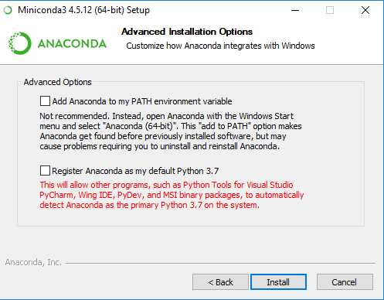
Setting up Python
Installation:
Miniconda: a free minimal installer for conda
an open source package management system that quickly installs, runs and updates packages and their dependencies. Runs on Windows, macOS and linux.
https://docs.conda.io/en/latest/miniconda.html
Find your Operating System
Download Python 3.8
Install it following the steps and make sure to check:

Slide 26
Setting up Python
Installation:
Miniconda: a free minimal installer for conda
an open source package management system that quickly installs, runs and updates packages and their dependencies. Runs on Windows, macOS and linux.
https://docs.conda.io/en/latest/miniconda.html
Find your Operating System
Download Python 3.8
Install it following the steps and make sure to check:

Slide 27

Virtual Environments
Python apps will often use packages and modules that are not part of the standard library
Apps sometimes need a specific version of a library
This means, one single Python installation may not meet the requirements of every application
The solution is to create a virtual environment, a self-contained directory that contains a Python installation (version) and the necessary packages
Pandas 1.0
App 1
Python 3.7
App 2
Pandas 0.25
App 3
Python 3.8
App 1
environment 1
Python 3.7
Pandas 1.0
App 2
Environment 2
Python 3.7
Pandas 0.25
App 3
Environment 3
Python 3.8
Pandas 0.25

Slide 28
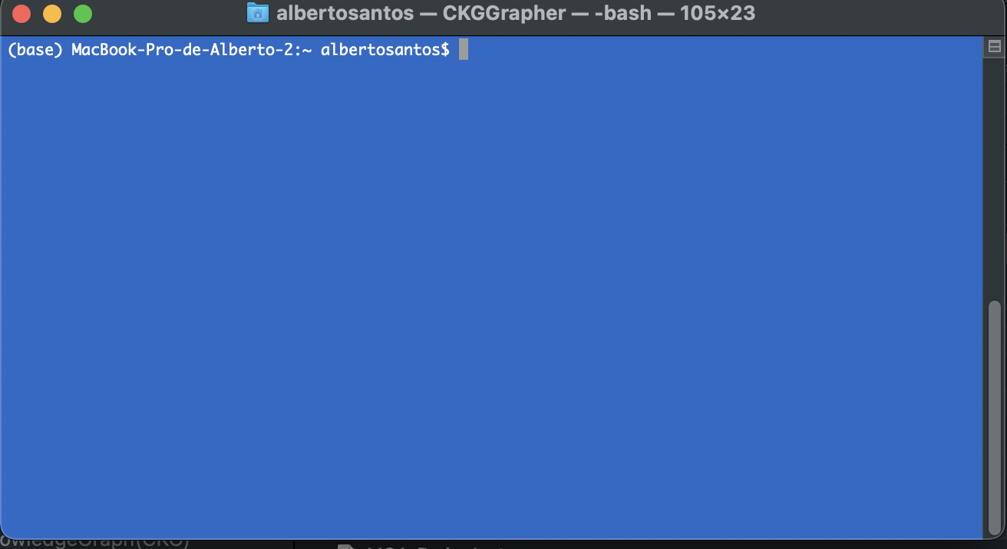
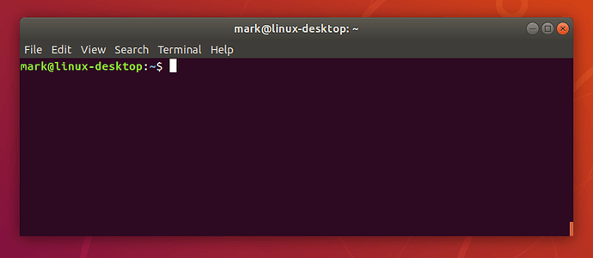
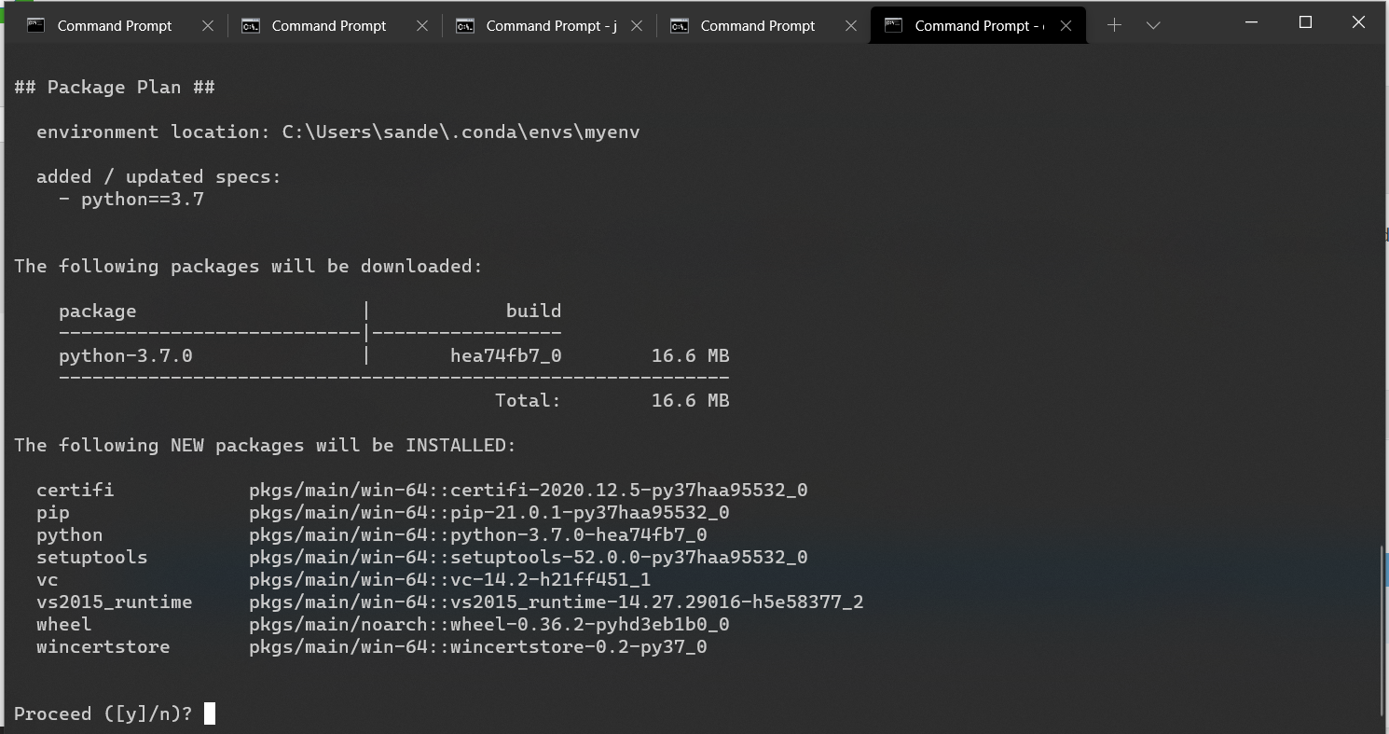
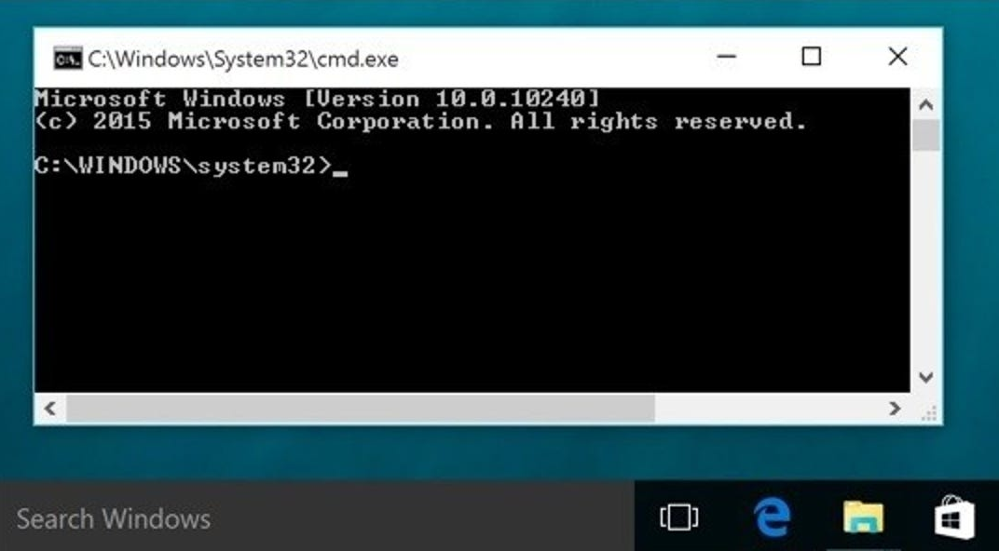
Virtual Environments
Let’s create a virtual environment:
To create an environment we use:
conda create -n name_env python==version
Open a Terminal window
Type conda create -n myenv python==3.7 and ‘y’
To activate the environment type:
conda activate myenv
Now, if we type python we have the right python version
App 1
environment 1
Python 3.7
Notes:
Basic python
Import library → error
Exit() and install library
A better way → environments

Slide 29
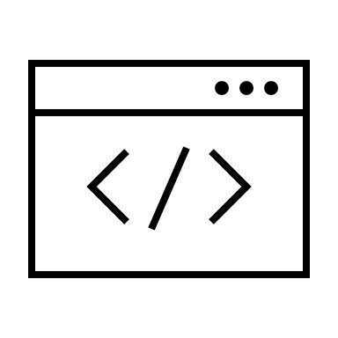



What tool do I use for coding?
Terminal → 2 options:
Shell: python
Interactive shell: ipython
Simple text editors:
Notepad++
Vim
Integrated development environments (IDEs) → Several options:
IDLE
PyCharm
Spyder
Visual Studio Code
Notebooks

Slide 30


Jupyter Notebooks
The Jupyter Notebook is an open-source application to create and share documents that contain code, equations, visualizations and text (markdown)

Slide 31
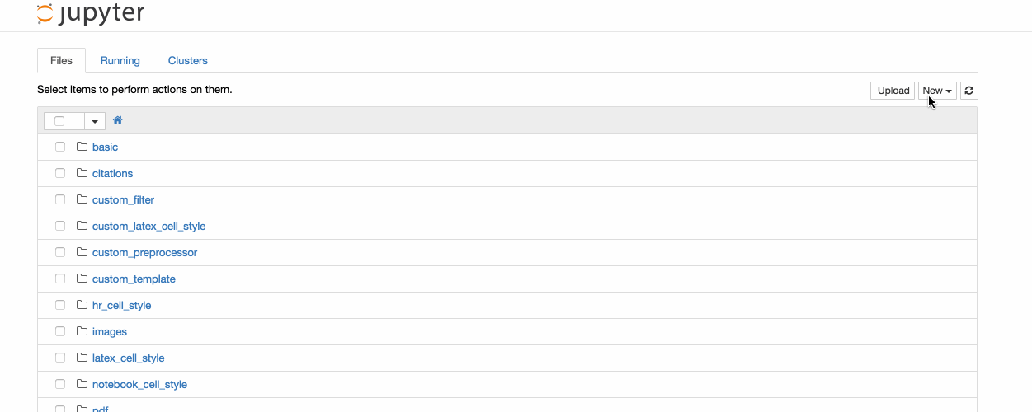
Jupyter Notebooks
Let’s install Jupyter Notebooks:
Open a Terminal window
Activate your environment:
conda activate myenv
Use pip to install Jupyter*:
pip install notebook
To start notebooks:
jupyter notebook
*This is where some OS may start complaining
Notes:
Basic python
Import library → error
Exit() and install library
A better way → environments

Slide 32


Google Colab
Colab (Colaboratory) is a tool to write, execute and share python code through the browser
Colab is especially well suited to machine learning, data analysis and education.
Colab is a hosted Jupyter notebook service that requires no setup to use, while providing free access to computing resources including GPUs
It is connected to a Google account and data can be accessed through Google Drive.
https://colab.research.google.com/

Slide 33





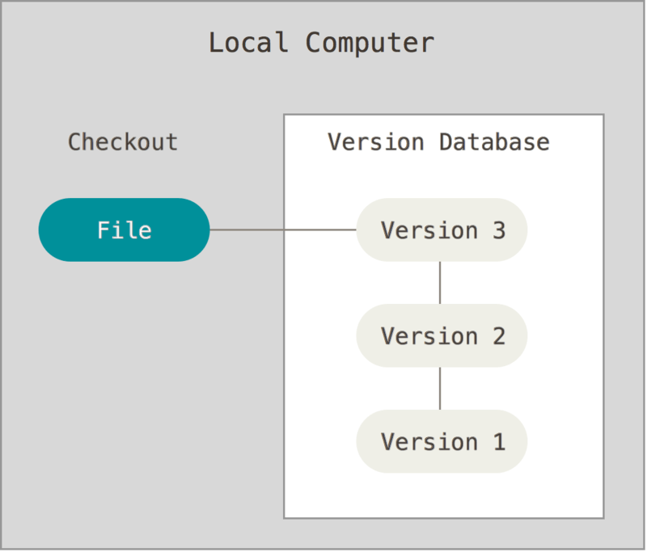


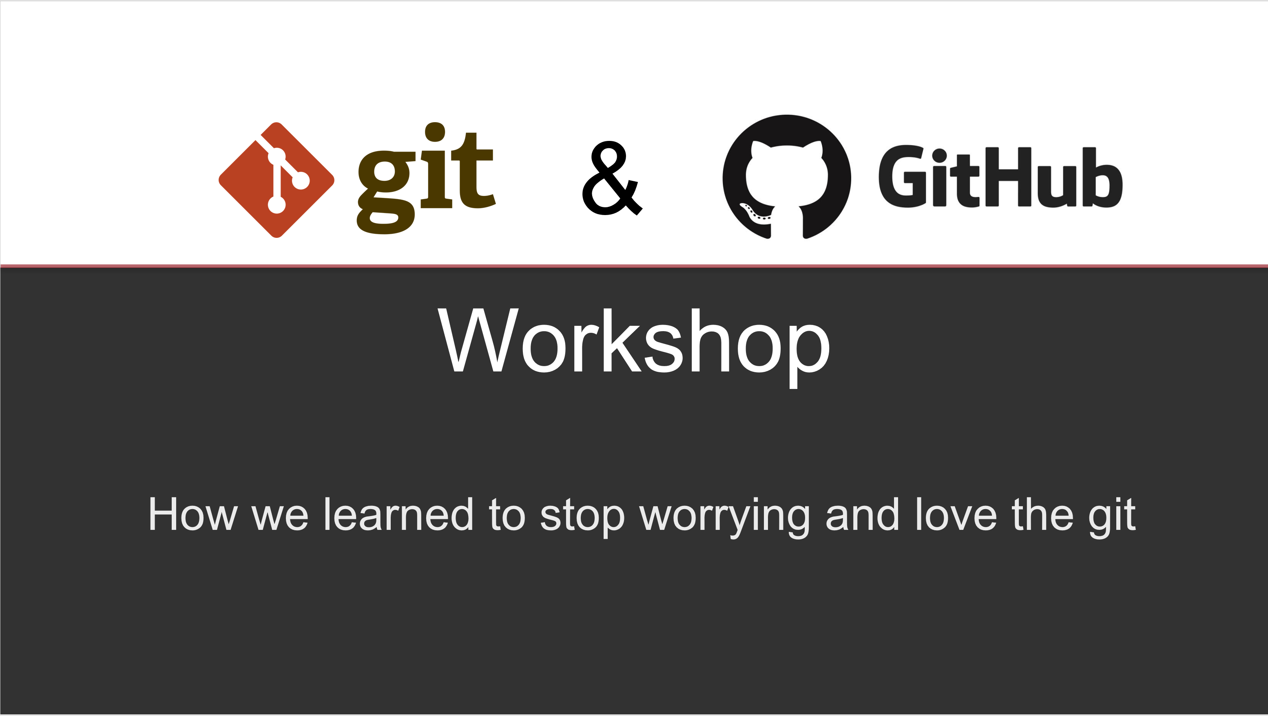
Taking Control of Your Code
manuscript_draft.doc
manuscript_draft2.doc
manuscript_draft3.doc
manuscript_final1.doc
manuscript_final33_mod_JADH_GGS_final44_reviewed_FH_2.2.1.doc
Version control
It is a system that records changes to a file or set of files over time so that you can recall specific versions (history)
Important in coding, especially when the code is accessed by “many” people (>1)
A good way to share your code with others
Git is a software for tracking changes and coordinating work among collaborators developing code
GitHub facilitates access to Git’s functionality
Recommended
https://github.com/Center-for-Health-Data-Science/PythonTsunami

Slide 34


